Slide 1
UCSD Embedded C Assignment 8
By
Hsuankai Chang
hsuankac@umich.edu

Slide 2
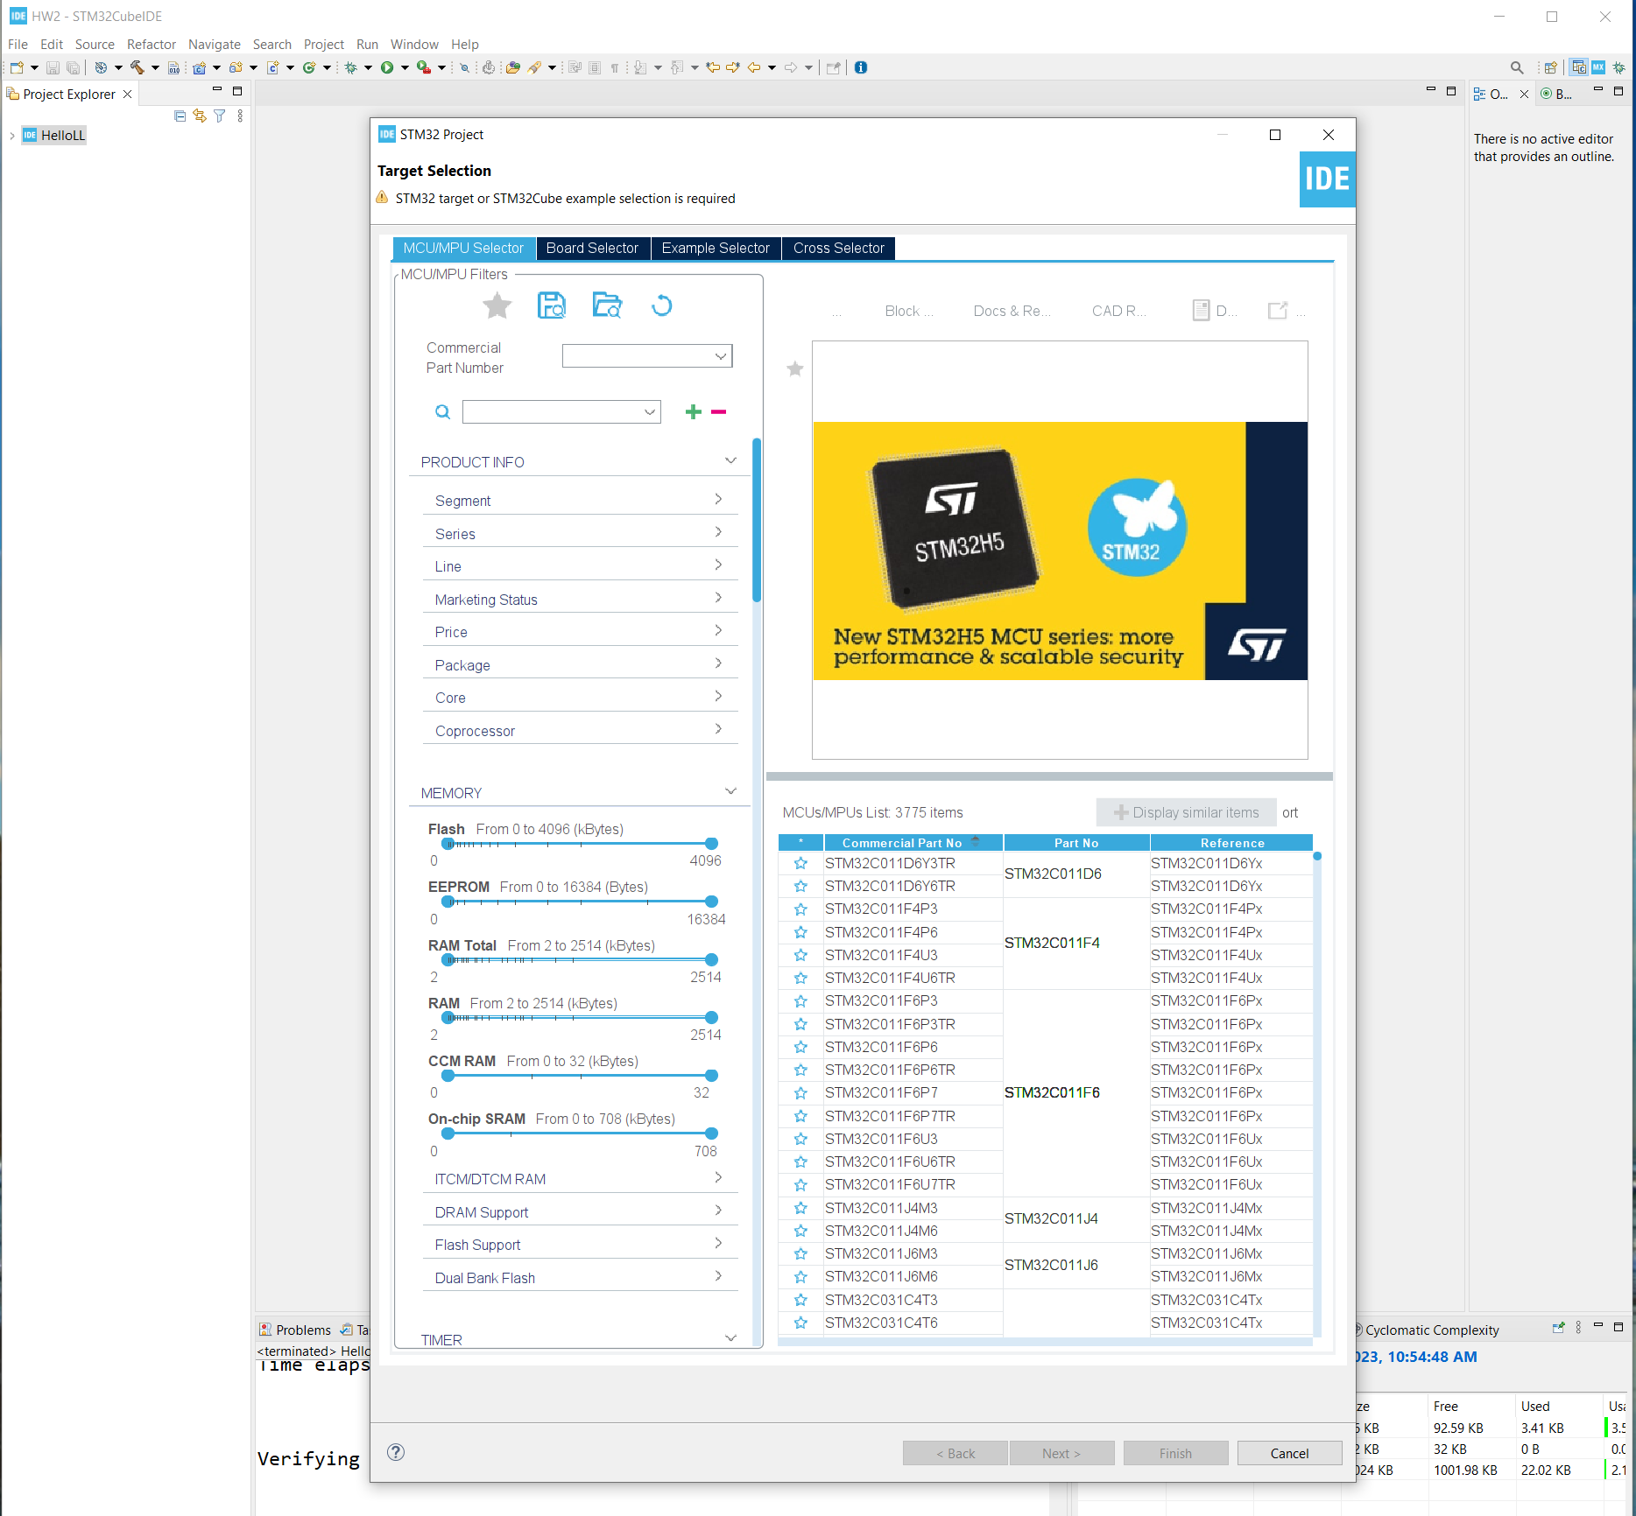
Step 1. Startup STM32CubeIDE and create new STM32 project

Slide 3
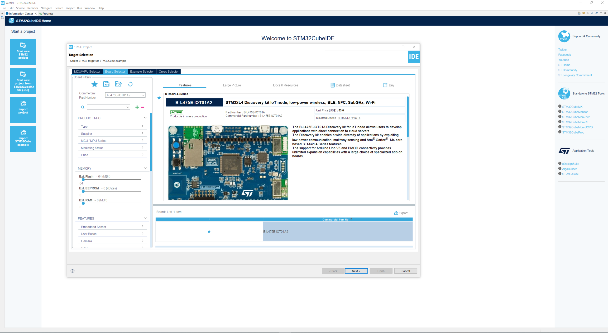
Step 2. Access board selector and type in the board you use, click Next

Slide 4
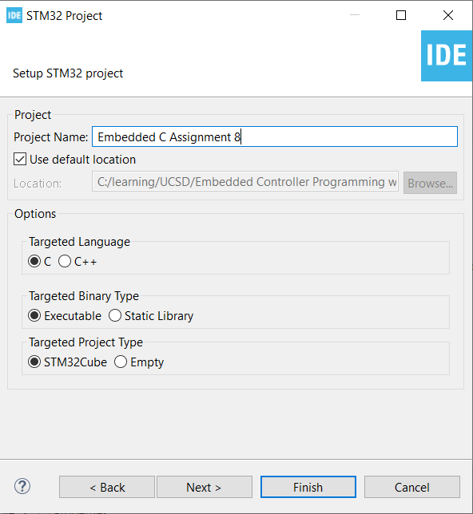
Step 3. Enter the project name then click Next

Slide 5
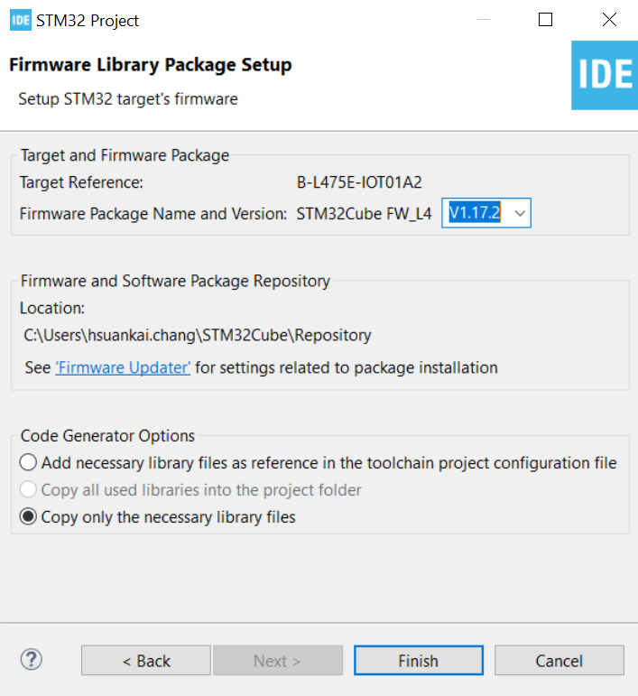
Step 4. See the firmware package name and version

Slide 6
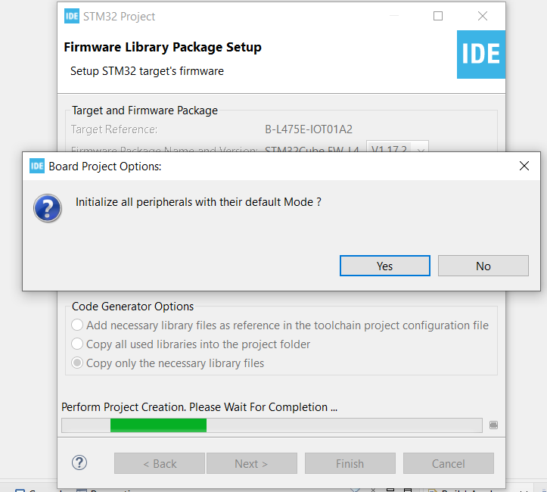
Step 5. Click yes to initialize all peripherals to default

Slide 7
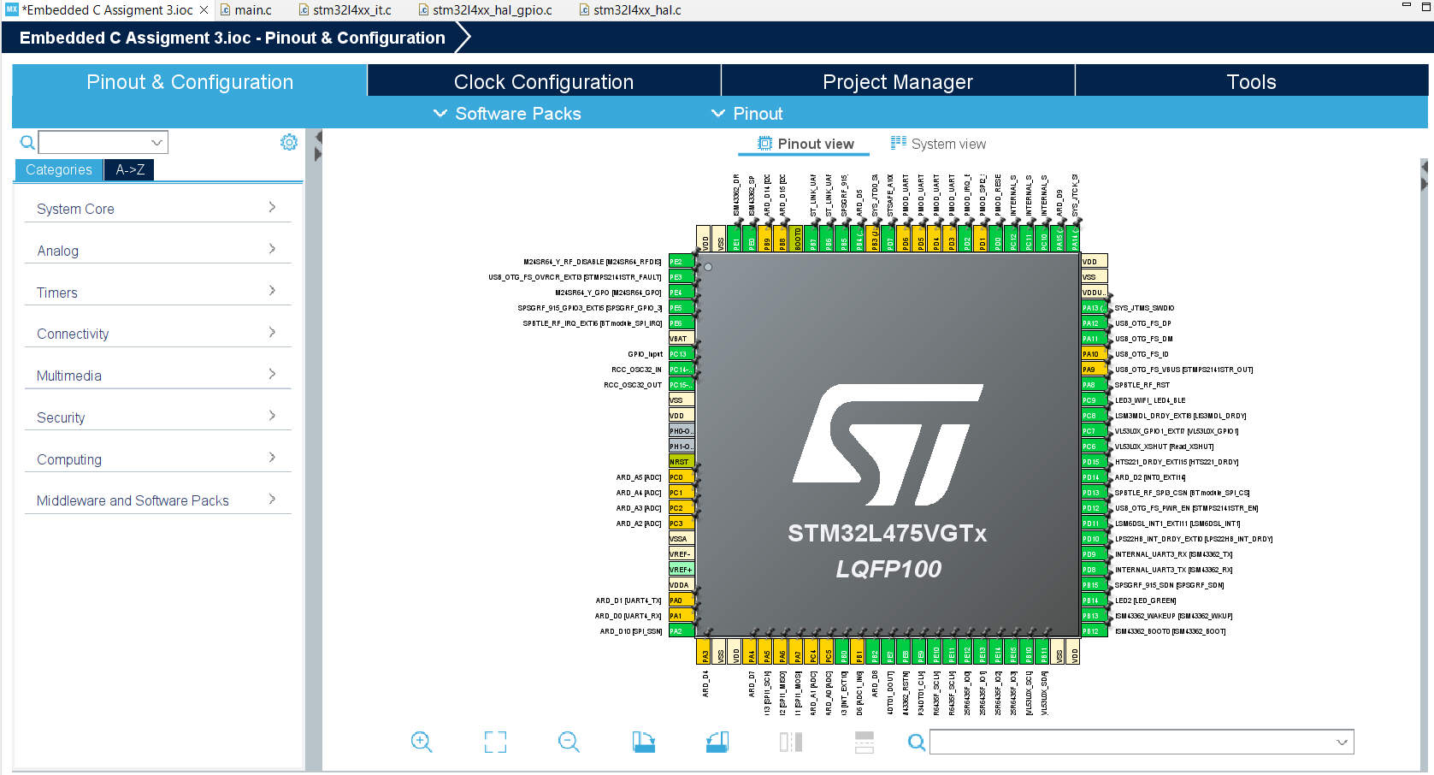
Step 6. When in .ioc file, click System view

Slide 8
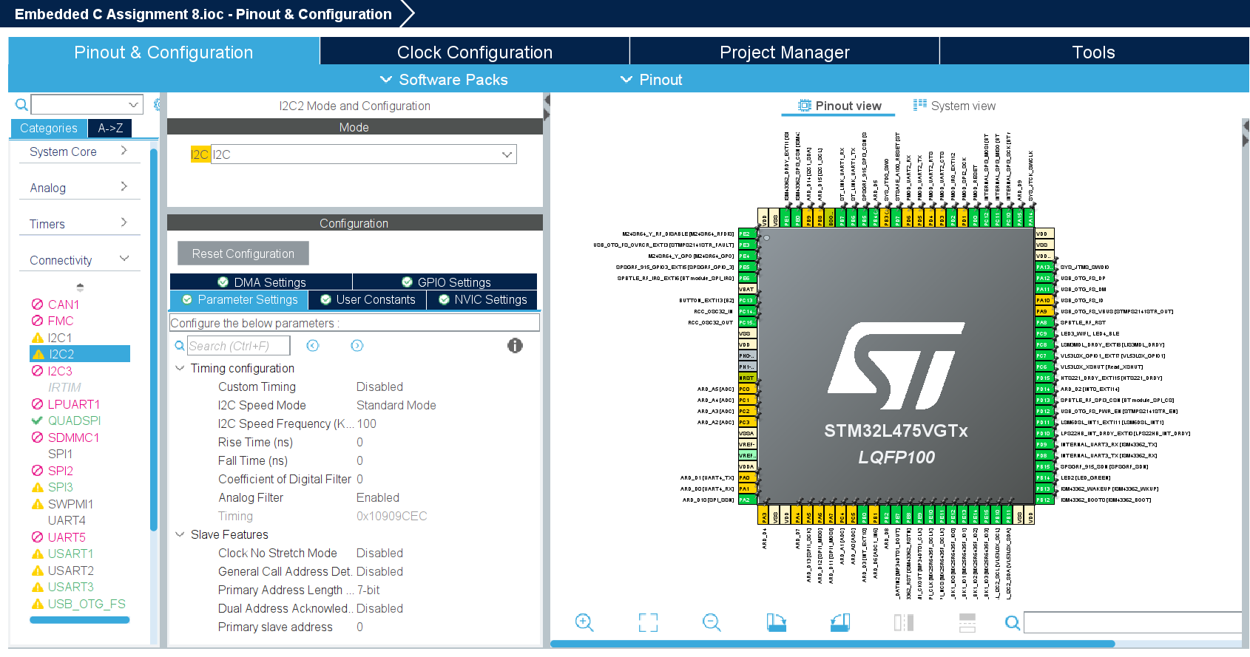
Step 7. Check the setting for I2C2 to communicate with HTS221 sensor

Slide 9
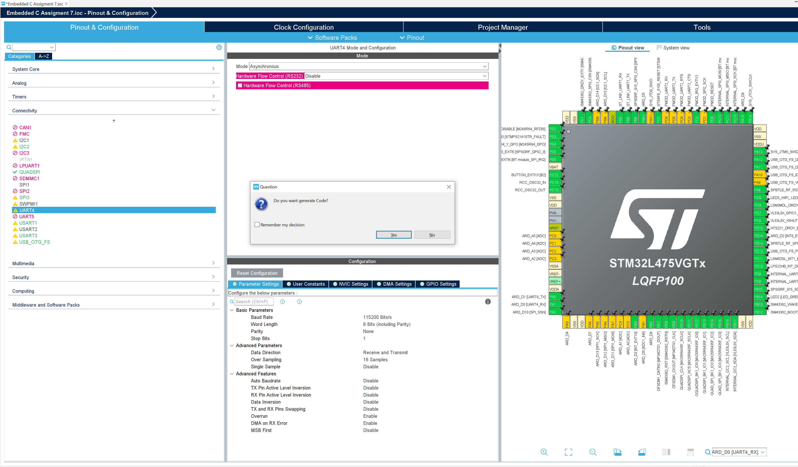
Step 8. Generate code

Slide 10
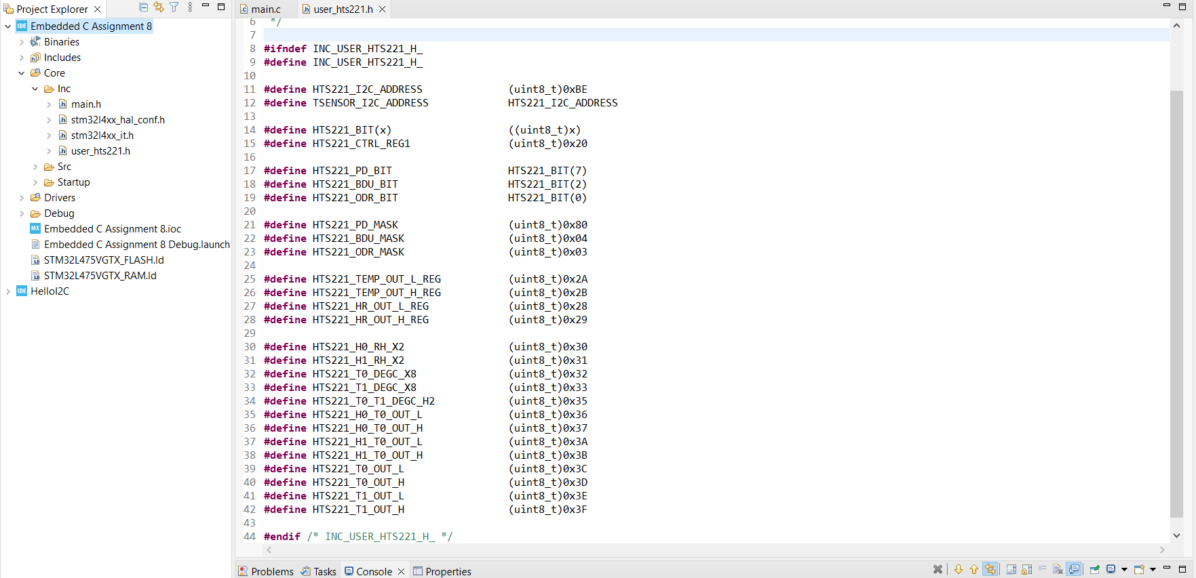
Step 9. In core/include folder, create user_hts221.h file to store necessary macros

Slide 11
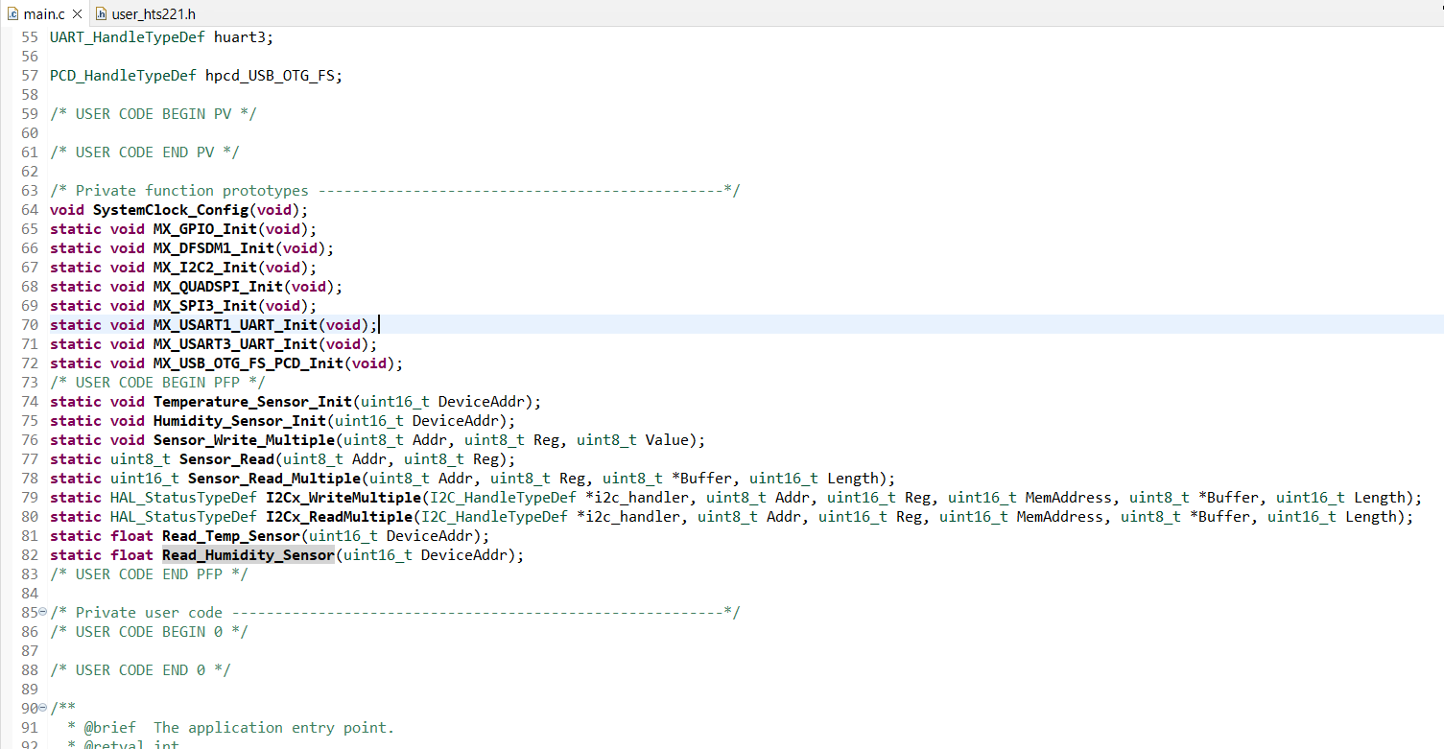
Step 10. In main.c file, create private function prototypes

Slide 12
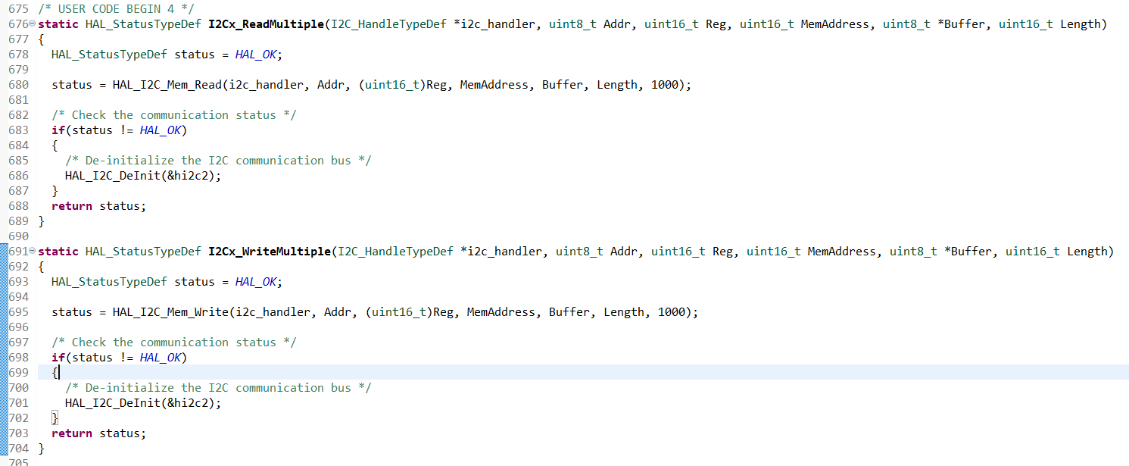
Step 11. In main.c file, write the function definition for read/write to and from sensor using I2C

Slide 13
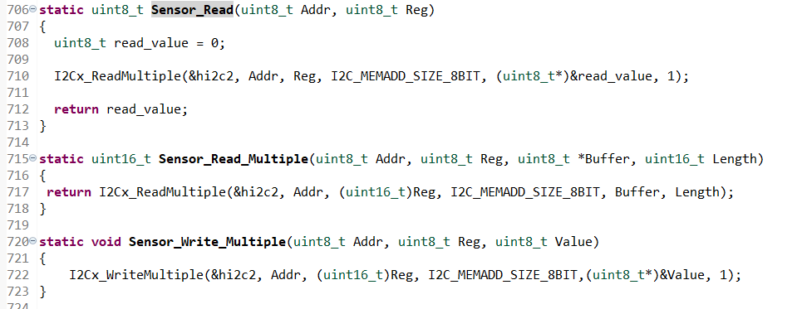
Step 12. In main.c file, create API function to use those read and write functions

Slide 14
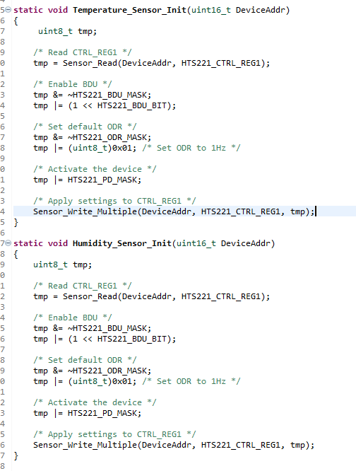
Step 13. Write functions for initialization. Since I2C initialization and GPIO pin alternate function configuration, priority setting, etc. already done in MX_I2C2_Init function, we don’t need to do it again

Slide 15
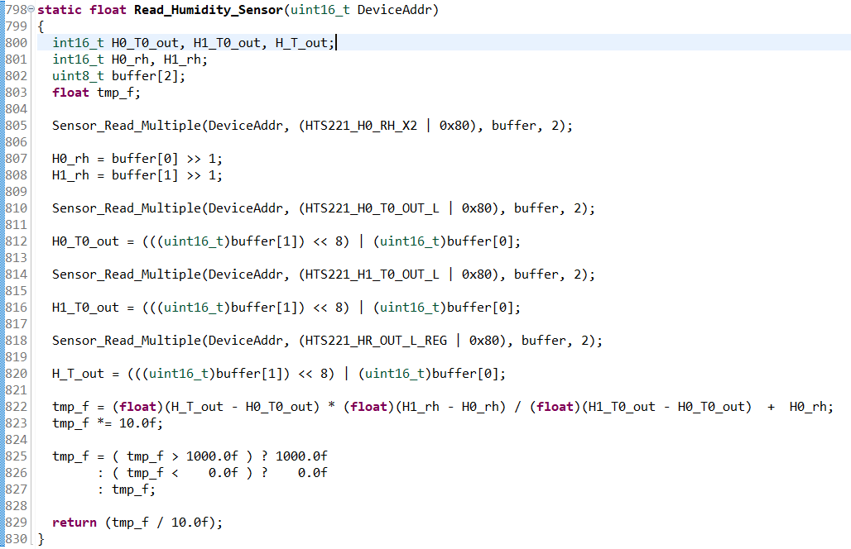
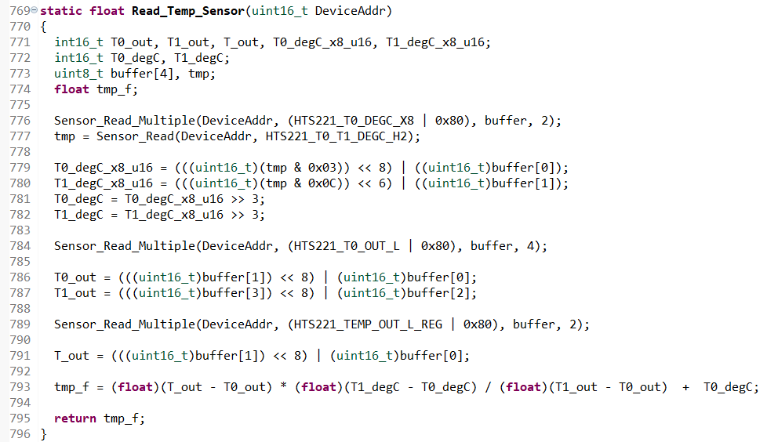
Step 14. Implement read data from temperature and humidity sensor

Slide 16
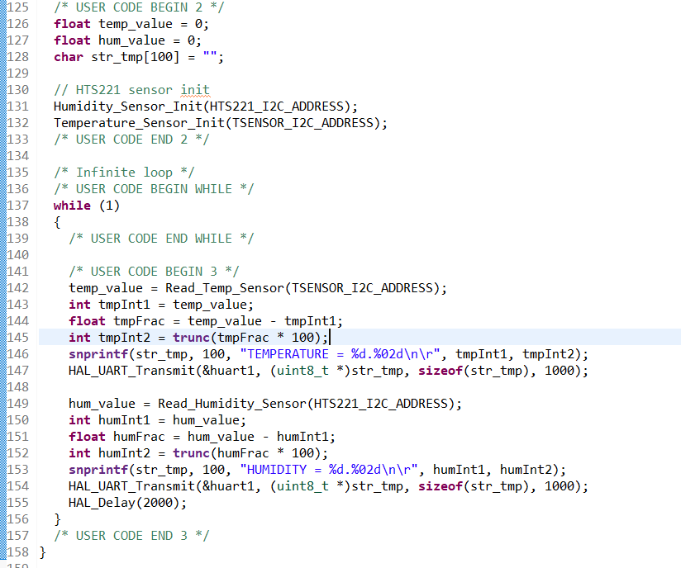
Step 15. In main function, implement the driver code to read temp and humidity value then print it out on UART1

Slide 17
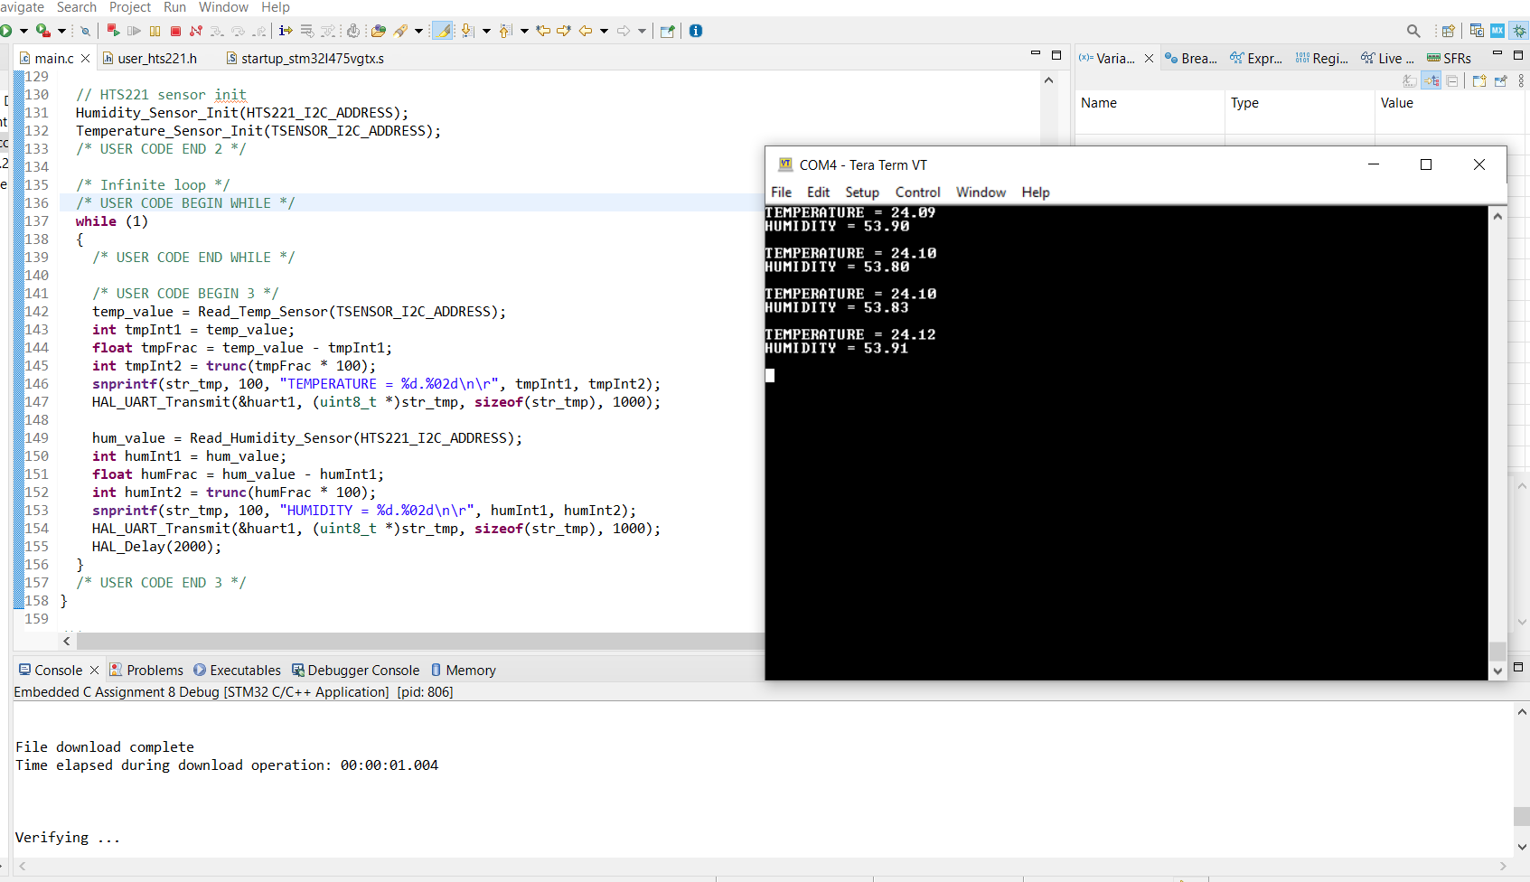
Step 16. Compile and run in debug mode, open tera term and setup the terminal, then we can see the value

